Slide 1
DYSLEXIA KNOWLEDGE SERIES: What Educators Need to Know About Dyslexia Training Programs
Dr. Jennifer H. Lindstrom: University of Georgia Dr. Nora Wersich Schlesinger: Kennesaw State University

Slide 2
Agenda
IDA Knowledge Practice Standards
IDA-Accredited Programs
Certificate Programs
Independent
College and University
Endorsement Programs
Evaluating and Selecting Programs

Slide 3
IDA Knowledge Practice Standards (KPS): Overview
International Dyslexia Association (IDA)
The KPS define and outline the knowledge and skills teachers of reading should know and utilize
To support all students’ reading proficiency
Educator Training Initiative refined the KPS in 2018
To align educator preparation resources with KPS
For example: publications, webinars, etc.
To encourage application of KPS in pre-service and in-service educator preparation programs
International Dyslexia Association (IDA), 2021a

Slide 4
IDA KPS: Overview
The KPS consists of 5 standards and associated sub-standards:
Standard 1: Foundational Literacy Acquisition
Sub-standards 1.1-1.9 present foundational reading development concepts and difficulties derived from interdisciplinary research
Standard 2: Knowledge of Diverse Reading Profiles, including Dyslexia
Sub-standards 2.1-2.5 cover knowledge of diverse reader profiles, including dyslexia, very slow reading, and language comprehension
Standard 3: Assessment
Sub-standards 3.1-3.8 pertain to assessment knowledge relevant to evidence-based practices within RTI framework
IDA, 2021b

Slide 5
IDA KPS: Overview
Standard 4: Structured Literacy (SL) Instruction
Sub-standard A-G addresses SL teaching, with in-depth guidance to effective instruction in major skill domains
e.g., phonological and phoneme awareness, phonics and word recognition, reading fluency, vocabulary, listening and comprehension, and written expression
Expectations for teachers’ preparation fieldwork or practicums
e.g., interpretation of assessments, differentiated instruction, lesson design, corrective feedback, etc.
Standard 5: Professional Dispositions and Practices
Sub-standards 5.1-5.10 outline ethical standards for the profession
IDA, 2021b

Slide 6
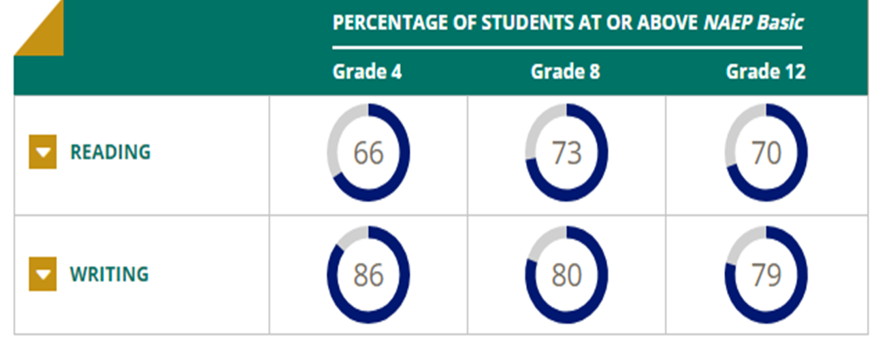
KPS: Who Uses KPS and Why
Who:
Educator preparation providers (EPP) for the certification of literacy educator programs and for professional literacy development facilitators
Why:
Let’s look at NAEP statistics for a summation
The Nation's Report Card, 2017
Notes:
National Assessment of Educational Progress
Reading: 66 %, 73 %, 70 % of grades 4, 8, and 12 students performed at or above NAEP Basic Level in 2019, respectively
Reading assessment include literary and informational texts
Writing: 86%, 80%, 79% of grades 4, 8, and 12 students performed at or above NAEP Basic Level in 2019, respectively
Basic – Indicates partial mastery of prerequisite knowledge and skills necessary for performance at Proficient level
Proficient – Reading at this level demonstrates competency with challenging content specific information and application of knowledge and analytical skills
NAEP results consistently shows approximately 31% of ALL grade 4 students read at a level below Basic
This translates to only about 1/3 of grade 4 students are proficient or advanced (https://app.box.com/s/21gdk2k1p3bnagdfz1xy0v98j5ytl1wk)

Slide 7
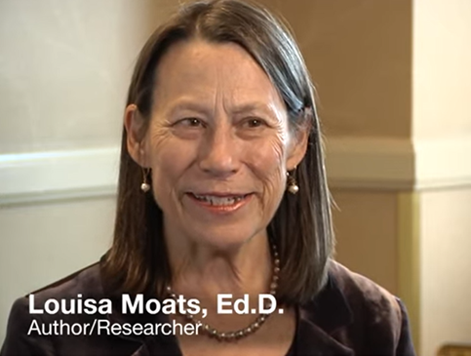
KPS: Why Continued
Most common issue for academic achievement is reading
About 85% of public special education referrals are due to problems with language, reading, and/or writing (IDA, 2021a)
Educators need to be highly trained to teach reading, especially to struggling individuals
A research to practice gap exists in professional institutions for licensing and preparation of educators (e.g., Joshi et al., 2009; Moats, 1994; Sayeski et al., 2017)
(IDA, 2021b, Moat, 1994)
Notes:
Basic – Indicates partial mastery of prerequisite knowledge and skills necessary for performance at Proficient level
Proficient – Reading at this level demonstrates competency with challenging content specific information and application of knowledge and analytical skills
80% of learning-disabled students have their primary problem in reading (Lerner, 1989)

Slide 8
IDA Accreditation
Accreditation process is unlike other higher education accrediting bodies
The IDA accreditation process promotes systematic evaluation and refinement of educator preparation programs using research-based KPS
Programs ensure educators of K-12 have the mastery of SL™ principles and practices
Graduates possess the knowledge and skill to prevent reading failure and to provide literacy remediation and intervention
Accredited programs prepare educators for literacy instruction for all students
IDA, 2021b

Slide 9
IDA-Accredited Programs in Higher Education
STATE | INSTITUTION | CREDENTIAL/PROGRAM | ACCREDITATION LEVEL
AR | University of Central Arkansas | UGrad Elementary Education/Grad Reading | Accreditation/Accreditation^{Plus}
CO | Colorado College | Grad Literacy Intervention Specialist Program | Accreditation^{Plus}
CT | Fairfield University | Grad Reading and Language Development | Accreditation^{Plus}
 | Southern CT State University | Grad Reading | Accreditation^{Plus}
FL | Southeastern University | UGrad Elementary Education with Reading/ESOL Endorsements | Accreditation
 |  | UGrad Special Education with Reading/ESOL Endorsements | Accreditation^{Plus}
 | University of Florida | Dyslexia Certificate Program | Accreditation^{Plus}
MA | Gordon College | Grad: Reading Specialist | Accreditation^{Plus}
 | MGH Institutes of Health Professions | Grad Reading | Accreditation^{Plus}
IDA, 2021a

Slide 10
IDA-Accredited Programs in Higher Education
STATE | INSTITUTION | CREDENTIAL/PROGRAM | ACCREDITATION LEVEL
MS | University of Southern MS | Grad Dyslexia Therapy | Accreditation^{Plus}
 | William Carey University | Grad Dyslexia Therapy | Accreditation^{Plus}
NJ | Fairleigh Dickinson | Certificate: Orton-Gillingham Teacher | Accreditation^{Plus}
NY | Columbia University | Grad Reading Specialist | Accreditation^{Plus}
OH | Anitoch University Midwest | Certificate: Dyslexia Certificate Program | Accreditation^{Plus}
 | Mount Saint Joseph’s University | Grad: Reading Science Program ENDORSEMENT: Reading | Accreditation^{Plus}
 | Notre Dame College | Reading Endorsement | Accreditation^{Plus}
 | University of Dayton | UGrad Early Childhood/Middle Level/Intervention Specialist Grad Reading Endorsement | Accreditation^{Plus}
IDA, 2021a

Slide 11
IDA-Accredited Programs in Higher Education
STATE | INSTITUTION | CREDENTIAL/PROGRAM | ACCREDITATION LEVEL
PA | Arcadia University | Grad: Reading Specialist Program | Accreditation^{Plus}
 | Clarion University | Grad: Special Education: Reading Concentration | Accreditation
 | Drexel University | Grad Special Education: Multisensory Reading Concentration | Accreditation^{Plus}
 | Robert Morris University | Grad: Reading Specialist & Structured Literacy Intervention Certificate | Accreditation/Accreditation^{Plus}
 | Saint Joseph’s University | Grad: Special Education M.S.: Special Education/Systemic Literacy B.S.: Elementary Education PreK-4 Special Education | Accreditation^{Plus} Accreditation^{Plus} Accreditation
 | Temple University | UGrad: Early Childhood Education (ECED) UGrad: ECED/Special Education | Accreditation
TX | Southern Methodist University | Grad: Reading and Writing | Accreditation^{Plus}
IDA, 2021a

Slide 12
IDA Accreditation Categories and Requirements
Accredited Program
These programs prepare candidates to serve as general education classroom teachers or support personnel to provide or support:
Whole group reading and language arts instruction to students in general education contexts; and/or
Small group instructional practice opportunities for students who are not meeting grade level reading expectations in general education Response to Intervention (RTI) and Multi-Tiered Systems of Support (MTSS) contexts
These programs are not preparing professionals to pro.vide specialized, remedial reading interventions to students
IDA, 2020

Slide 13
IDA Accreditation Categories and Requirements
Accredited Program^{PLUS}
These are programs that prepare candidates to provide targeted or intensive reading interventions that reflect the principles and practices of SL™ to individual and small groups of students who have a primary need for remediation of decoding-strand skills (phonological awareness, phonics, and fluency).
Students may be deemed as “at-risk,” may have an identified Specific Learning Disability, or may have an identification of Dyslexia.
IDA, 2020

Slide 14
IDA Accreditation Categories and Requirements
Accredited Program^{PLUS}
Must provide evidence that:
Their curriculum is adequately aligned with the KPS sufficient for candidates to earn a passing score on the KPEERI exam
They require candidates to complete at least one supervised SL™ practicum experience; and
Their supervised SL™ practicum experience(s) are implemented by appropriately credentialed faculty and designed to ensure that candidates meet minimum SL™ practice and competency thresholds.
Requires a virtual site visit
IDA, 2020

Slide 15
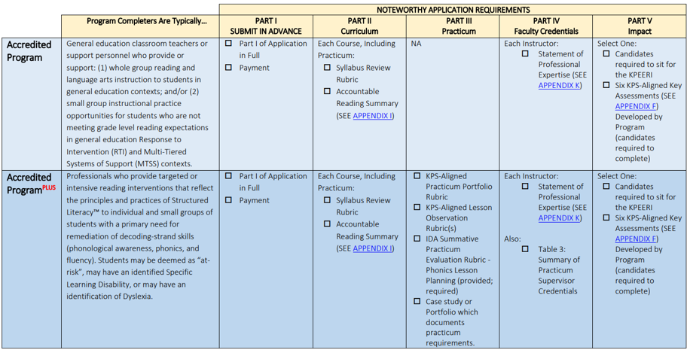
IDA Accreditation Application Requirements
IDA, 2020

Slide 16
Structured Literacy™ Certification
Certification credential indicating an educator’s knowledge and ability to utilize KPS to positively impact individuals
At risk for reading failure
Identified with a specific learning disability, including dyslexia
Certification Exams
Knowledge and Practice Examination for Effective Reading Instruction (KPEERI)
Application managed by the Center for Effective Reading (CERI)
Passing exam provide a CERI certification
Structured Literacy™ Classroom Teacher Certificate
Structured Literacy ™ Dyslexia Interventionist (SLDI)
Structured Literacy ™ Dyslexia Specialist (SLDS)
(CERI Certification Guidelines)

Slide 17
CERI Certification
Programs desiring CERI certification for their graduates must meet the practicum requirements for the interventionist and specialist level
Certified Structured Literacy Dyslexia Interventionist (C-SLDI)
Min. 90 hours training
Passing Score on KPEERI Exam
Practicum
Under Direction of IDA Accredited Partner
1 Student
Passing Score on Practicum Portfolio
Minimum:
Two Academic Semesters each:
12 Consecutive Weeks
24 Sessions
2x/week for 60 minutes non-consecutive days or 3x/week for 45 minutes
3 Formal Lesson Observations/Conferences with Write-Up
Common Role of the Certified Structured Literacy/Dyslexia Interventionist
Provides targeted or intensive reading intervention services that reflect the principles and practices of Structured Literacy to individual and small groups of students
Students typically have a primary need for decoding strand instruction (phonological awareness, phonics (including decoding and encoding), and fluency)
IDA, 2020

Slide 18
Academic Language Therapy Association (ALTA)
Credentialing organization with rigorous standards to assure quality services for individuals with dyslexia
ALTA Competency Exam for Multisensory Structured Language Education© (MSLE)
International Multisensory Structured Language Education Council (IMSLEC) accredits quality MSLE
Complete application and when it is approved, register for the exam
Passing exam provide the following levels of certification
Certified Academic Language Practitioner (CALP)
Certified Academic Language Therapist (CALT)
Instructor of Certified Academic Language Practitioner (ICALP)
Qualified Instructor of Certified Academic Language Therapists and Practitioners (QI)
Altaread.org
Altaread.org

Slide 19
Independent Certificate Programs
International Multisensory Language Education Council (IMSLEC)
Multisensory Structured Language Education – Professional Preparation in Dyslexia
IMSLEC accredited centers meet IDA standards for teachers of reading
Academic Language Therapy Association (ALTA) is the professional credentialing organization
Training provides direct instruction in each category of the IMSLEC-specified MSLE content
Participants required to demonstrate IMSLEC-specified principles of instruction
Training services are evaluated and documented on a systematic and continuing basis
IMSLEC, 2002-2021

Slide 20
IMSLEC/ALTA Practitioner Levels
IMSLEC/ALTA | Degree Required | Prior Requirements | Course hours | Practicum; observations | Length of program: Min
Teaching/CALP | Bachelor’s | Program discretion | 45 | 60 hours/5 direct observations | 9 months
Instructor of Teaching/NA | Bachelor’s | Teaching level certified 600-hours | 90 | 1 cycle of teacher training observation by trainer | 1 cycle of teacher training
Therapy/CALT | Master’s | Program discretion | 200 | 700/500/350 hrs 10/15/20 observations | 24-month
Instructor of Therapy/ Qualified Instructor | Master’s | MSL therapist 1400 hrs beyond therapist level | N/A | 2100 hours; Observation participate in therapy training | 3 years Certified MSLE Therapist 2-year internship, MSLE program
All require 30 hours of CEUs over 3 years
(IMSLEC, 2002-2021)
Notes:
Instructor of Teaching:(2 years with variety levels/ ages)
CALT: (small group with 3 cases in beginning &
upper levels)
MSL: 3 years minimum as MSL Therapist knowledge of other MSL programs
MSL observ: (including therapy level) participation in all facets of therapy training familiar with other MSL curriculums/ literature/
presentation skills

Slide 21
Independent Certificate Programs
Orton-Gillingham Accredited (OGA) Programs
OG accredited training programs ensure the community the program offered provides a high level of performance, integrity, and quality
Programs must meet objective and professional assessments through the accrediting committee
Instructional leadership of an instructional program needs to be a vested member of the OG Academy
Instructional leadership of a training program needs to be a vested member of the OG Academy
OGA , 2018

Slide 22
Orton-Gillingham Practitioner and Educator Levels
Levels | Degree Required | Prior Requirements | Course work | Practicum; observations | Length of program: Min
OG Classroom Educator Level | Bachelor’s | N/A | 30 hours | 50 hours 5 observations | 8 consecutive months
Associate Level (Opt. A or B) | Bachelor’s | N/A | Opt A: 60 hours; Opt B: 70 hours | 100 hours 10 observations | 8 consecutive months
Certified Level | Bachelor’s | Assoc. level; some require letter of rec. | 160 hours (60 hr. from Assoc.) | 300 hrs (100 hr. from Assoc.) 10 observations | 2 academic years
Fellow Level | Master’s | Certified level | 250 hours (90 hr. from Certification) | 600 hours (300 hr. from Cert.) 10 observations | 3 academic years
OGA, 2018
Notes:
Orton-Gillingham Classroom Educator Level: by Fellow or Fellow-in-Training
teaching complete lessons in a group (of at least 2 students) or classroom setting conducted by the Fellow (3 out of the 5 observations (FIT) or Clinical Supervisor (CS) as designated by the Fellow) on-site, unedited video or web-based application
Associate Level: by a Fellow or by a Fellow-in-Training (FIT) as designated by the Fellow
Option A: 100 hours teaching 1:1
Option B: 50 hours 1:1 and 50 hours teaching in a group (2 students) or classroom setting
observations of the trainee conducted by a Fellow (7 out 10 observations may be by a FIT or Clinical Supervisor (CS) as designated by the Fellow) on-site, unedited video or web-based application
Fellow: Experience teaching students of various ages and learning profiles
Evidence of continuing professional growth and development in the field of dyslexia beyond the Certified level
Notice to Academy office of the Fellow-in-Training from the Principal Training Fellow.

Slide 23
Programs that Follow OG Tenets
Barton Reading Program: Created by Susan Barton
Popular out West
Created to help students with dyslexia
Designed for non-professionals to teach students
Unlimited phone and online support
Students need to have phonemic awareness
10 levels
Certification via Zoom with
Candidate tutors Ms. Susan Barton acting as a student
Ms. Barton checks to make sure there is fidelity to procedures
Certification Beginning levels 1-3
Certification Advanced levels 4-6
Certification Masters levels 7-10
Understood, 2014-2021a

Slide 24
Programs That Follow OG Tenets
Wilson Reading System
Designed for students grade 2 and up
One of the few programs for adolescents
Using sound-tapping
Used in private/public schools and private tutors
12 units that take 2-3 years to complete
WRS Certification Level I and II
Level I: 90 hours online coursework and an intensive 60-lesson practicum
Level II: Complete Level I plus small-group instruction
Group mastery practicum
Advanced word study with students 7-12
Understood, 2014-2021b; Wilson Language Training, 2020-2021

Slide 25
Licensure, Certification, and Endorsements
Initial certification (licensure) is granted by the PSC and based on completion of an accredited teacher preparation program at a four-year teacher training institution
What is the difference between an endorsement and certification?
Certification refers to licensure to teach
Endorsement is the area in which you chose to teach, i.e., elementary, secondary math, special education, etc.
Additional endorsements can be added onto initial certification (e.g., ESOL, Dyslexia)
Endorsements do not necessarily increase a teacher's pay; sometimes districts pay a supplement for endorsements, but it is not a state-wide pay bump

Slide 26
College and University Certificate Programs
Typically offered at the graduate level
Do not lead to initial teacher licensure, administrator endorsement, or graduate degree (e.g., M.Ed.; M.A.T.)
Can enroll as non-degree or dual-enroll as a degree-seeking student
Do not require initial certification in educator program
Do not guarantee that the completion of the certificate will result in rank, endorsements, and/or salary increases
Strongly encourage interested individuals to contact their state licensure board prior to enrolling in a certificate program

Slide 27
Endorsement Program Approval Process
Guidance for Educator Preparation Providers (EPPs)

Slide 28
Endorsement Program Approval Process
The following organizations are eligible to seek GaPSC approval as an EPP for the purpose of preparing educators:
Regionally accredited institutions of higher education administratively based in the state of Georgia
Regionally accredited local units of administration with student enrollment over 30,000;
Regional Educational Service Agencies (RESAs)

Slide 29
Dyslexia Endorsement Completion
The Dyslexia Endorsement may be achieved through a stand-alone program or embedded in an initial preparation program or advanced/degree only program
The stand-alone program is a planned sequence of courses and field experiences offered independently of another program that leads to a certified educator meeting all Georgia Dyslexia Endorsement Standards for P-12 certification
An embedded endorsement addresses these standards through coursework and/or additional experiences and assessments within an existing program.

Slide 30
GaPSC Approved Dyslexia Endorsement Programs
Central Savannah River Area RESA
Georgia College and State University
Georgia State University
Griffin RESA
Metro RESA
Middle Georgia RESA
North Georgia RESA
Northwest Georgia RESA
Shorter University
Thomas University
University of Georgia
University of West Georgia
West Georgia RESA

Slide 31
Endorsement Programs: Candidate Eligibility
505-2-.192 DYSLEXIA ENDORSEMENT
(1) Eligibility Requirements.
To be eligible for the professional Dyslexia Endorsement, the applicant must hold a level four (4) or higher renewable professional certificate in any teaching, service or leadership field and complete other requirements outlined in GaPSC Rule 505-2-.14 ENDORSEMENTS.
To be eligible for the Five-Year Induction Dyslexia Endorsement, the applicant must hold a level four (4) or higher Five-Year Induction certificate in any teaching field and complete other requirements outlined in GaPSC Rule 505-2-.14 ENDORSEMENTS.
(2) In-Field Statement (See GaPSC Rule 505-2-.40 IN-FIELD ASSIGNMENT).
An individual with the Dyslexia Endorsement has strengthened and enhanced competency for recognizing the characteristics of dyslexia and the ability to support students with dyslexia in the field and at the grade levels of their base certificate fields.
Each state-approved curriculum course, with specified certificate fields that are designated as infield, may be found under Certification/Curriculum Assignment Policies (CAPS) on the GaPSC web site at www.gapsc.com

Slide 32
Evaluating and Selecting a Training Program
One size does NOT fit all!
Factors to consider
Alignment of curriculum with IDA KPS; IDA-accredited
Current and future role of the individual(s) seeking training
Previous training and experience of the individual(s) seeking training
Rigor and length
Qualifications of instructor(s)
Credential goal (e.g., degree, endorsement, certificate)
Cost

Slide 33
Scholarship Opportunities
IDA-GA Scholarship Program

Slide 34
References
Academic Language Therapy Association. (n.d.). Certification Exam. Retrieved from altaread.org: https://altaread.org/certification-exam/
Academy of Orton-Gillingham Academy Practitioners and Educators. (2018). Orton-Gillingham practitioner certification. Retrieved from Orton
Academy: https://www.ortonacademy.org/training-certification/individual-certification/
Center for Effective Reading Instruction. (n.d.). Certification Guidelines. Retrieved from The Center for Effective Reading Instruction:
https://effectivereading.org/wp-content/uploads/2019/07/FULL-CERI-GUIDELINES-JULY-2019-version.pdf
International Dyslexia Association (2021a). Educator Preparation Program Accreditation. Retrieved from International Dyslexia Association
Accreditation: https://dyslexiaida.org/educator-preparation-program-accreditation/
International Dyslexia Association (2021b). Final KPS for publication_May2018.pdf. Retrieved from Knowledge and Practice Standards for Teachers
of Reading: https://app.box.com/s/21gdk2k1p3bnagdfz1xy0v98j5ytl1wk
International Dyslexia Association, Program Review and Accreditation Handbook (2020). https://app.box.com/s/rkn64buf8iji6422nucr61zv37zla7oz
Joshi, M. R., Binks, E., Hougen, M., Dahlgren, M. E., Ocker-Dean, E., & Smith, D. L. (2009). Why elementary teacher might be inadequately prepared
to teach reading. Journal of Learning Disabilities, 42, 392-402.
Moats, L. C. (1994). The missing foundation in teacher education: Knowledge of the structure of spoken and written language. Annals of Dyslexia, 44,
81-101.
Sayeski, K. L., Gentry, A. E., Eslinger, R., & Whitenton, J. N. (2017). Teacher candidates' mastery of phoneme-grapheme correspondence: Massed
versus distributed practice in teacher education. Annals of Dyslexia, 67, 26-41.

Slide 35
References
The International Multisensory Structured Language Education Council. (2002-2021). The accreditation process. Retrieved from The International
Multisensory Structured Language Education Council: https://www.imslec.org/standards.asp
The Nation's Report Card. (2017). How did U.S. students perform on the most recent assessment. Retrieved from Nation's Report Card:
https://www.nationsreportcard.gov/
Understood. (2014-2021a). Barton reading program: What you need to know. Retrieved from Understood: https://www.understood.org/en/school-
learning/partnering-with-childs-school/instructional-strategies/barton-reading-program-what-you-need-to-know
Understood. (2014-2021b). Wilson reading system: What you need to know. Retrieved from Understood: https://www.understood.org/en/school-
learning/partnering-with-childs-school/instructional-strategies/wilson-reading-system-what-you-need-to-know
Wilson Language Training. (2020-2021). WRS level II certification. Retrieved from Wilson Language: https://www.wilsonlanguage.com/professional-
learning/individual-teacher-support/wrs-level-ii-certification/

